Slide 1
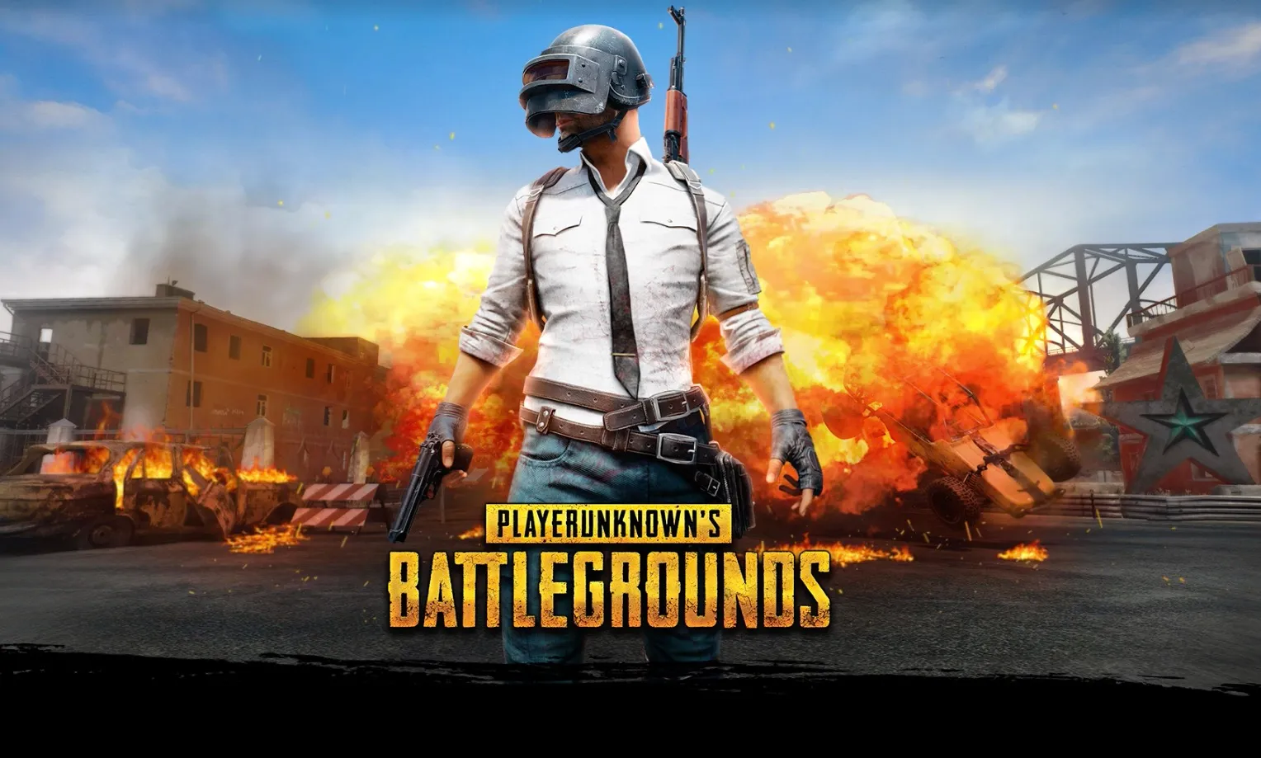
mDEV1003 ASSIGNMENT-1 Storyboard
GURWINDER SINGH, 200557497

Slide 2
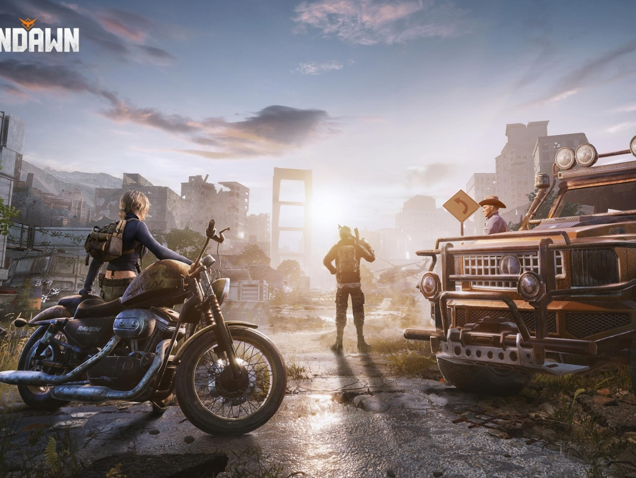
OVERVIEW
“PlayerUnknown’s Battlegrounds” is highly popular online multiplayer battle royale game developed and published by Corporation, a subsidiary of South Korean video game company Bluehole. It was created by Brendan “PlayerUnknown ”Greene and inspired By earlier mods he had designed for other games. PUBG was officially
released in Dec 2017 for PC and later for various consoles and mobile
for various consoles and mobile platforms.

Slide 3
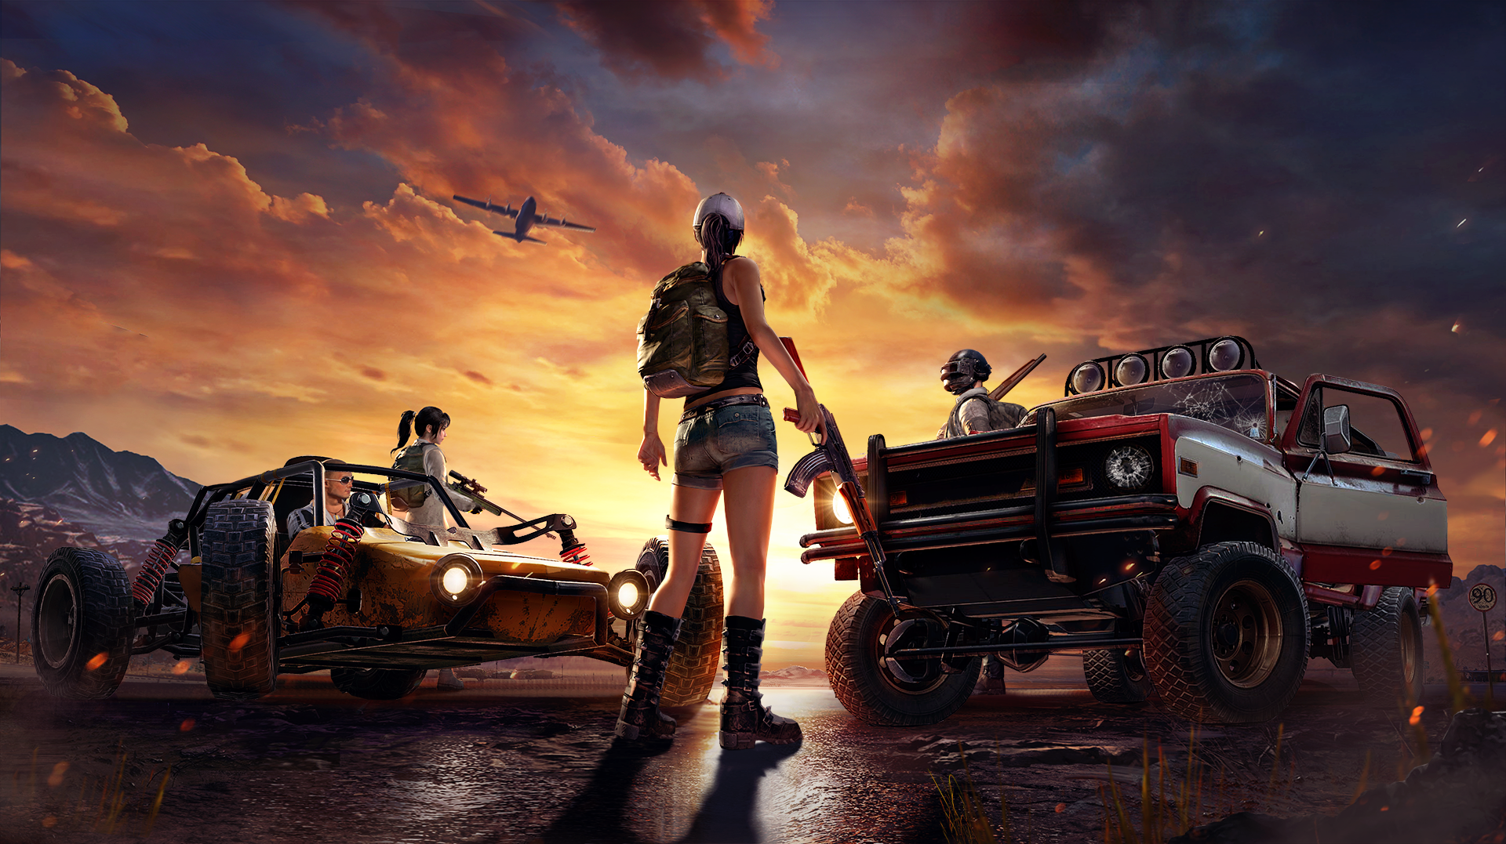
General Rules
Objective: Be the last player or team standing out of 100 participants.
Safe Zone: Players must stay within a shrinking safe playzone; leaving the zone results in damage.
Looting: Begin with no equipment; scavenge for weapons, gear, and supplies in buildings and loot crates.
Combat: Engage in battles with other players or teams using a variety of firearms and explosives.
Team Modes: Play solo, in duos (teams of two), or squads (teams of up to four).

Slide 4
General Rules
Reviving: In team modes, downed teammates can be revived, but if eliminated, they're out for the match.
Vehicles: Use vehicles for faster traversal but be mindful of their noise and visibility.
Circle Shrink: The playzone shrinks over time, forcing encounters and preventing camping.
Health Management: Use first aid kits, bandages, and energy drinks to heal and boost stats.
Inventory Management: Manage inventory space efficiently; prioritize essential items.

Slide 5
General Rules
Death: When eliminated, you're out of the match; no respawning until the next game.
Winning: Achieve victory by being the last person or team standing.
Strategy: Tactically choose when to engage, move, and use cover; communicate effectively in team modes.
Fair Play: Abide by the game's rules and code of conduct; no cheating or exploiting.
Updates: Stay updated with game changes, new maps, and weapon balancing.
Teamwork: In squad modes, teamwork and coordination are key to success.
Random Drops: Airdrops contain rare and powerful items, attracting player attention.

Slide 6
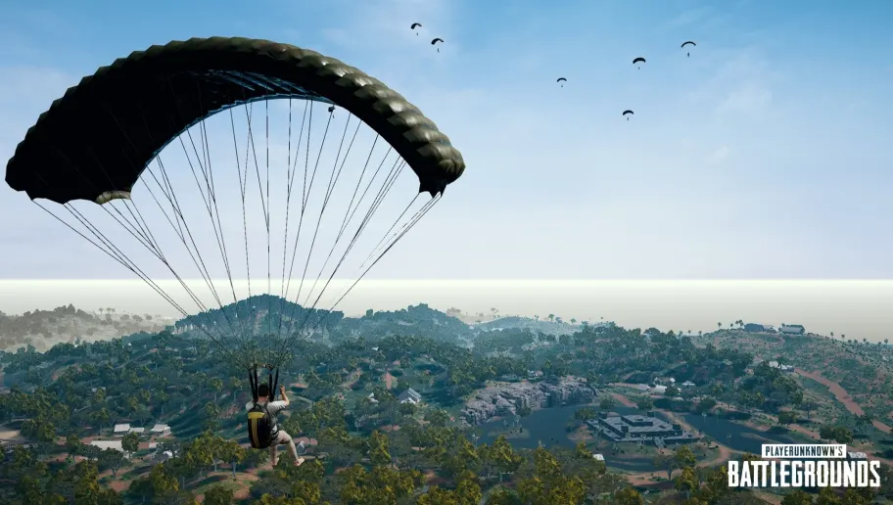
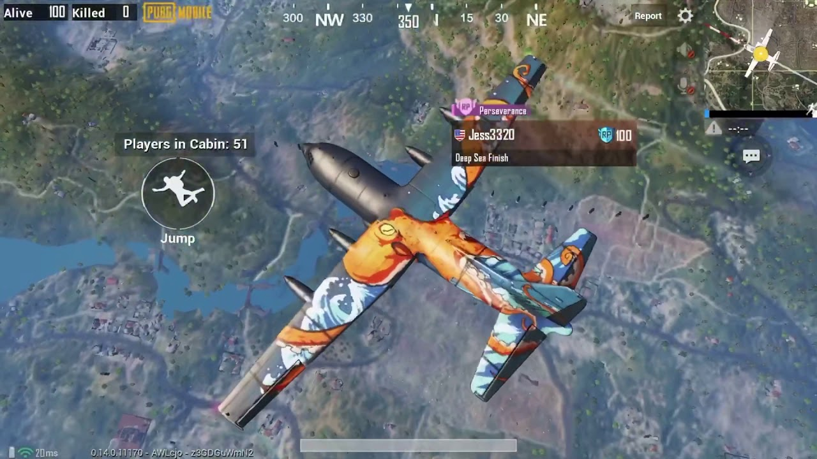
Parachuting
At the start of each match, players parachute onto the map from an airplane.
Players have the freedom to choose where they want to land, which can be a critical strategic decision.

Slide 7
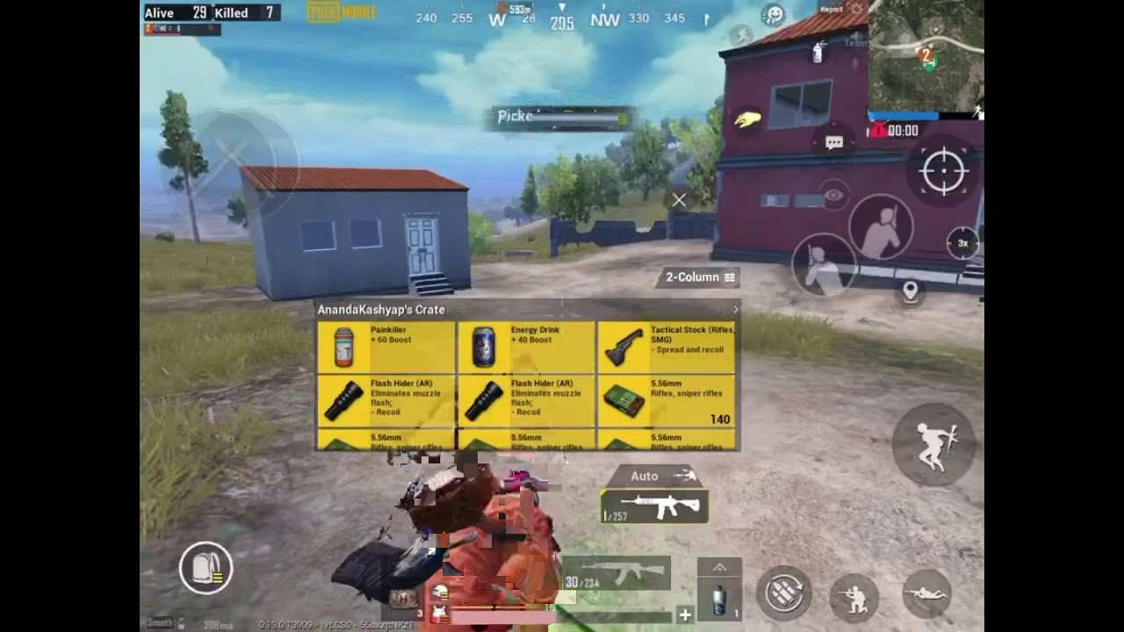
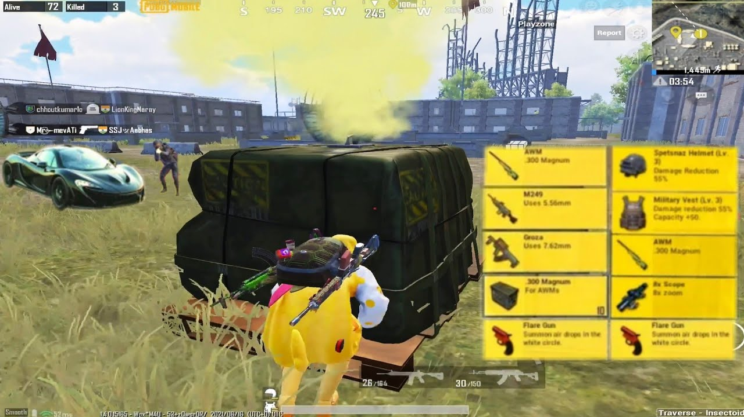
Looting: In PUBG, looting is a critical phase where players search for weapons, ammunition, armor, and other supplies immediately after landing. It's a race to equip yourself for combat and survival in the intense battle that follows.

Slide 8
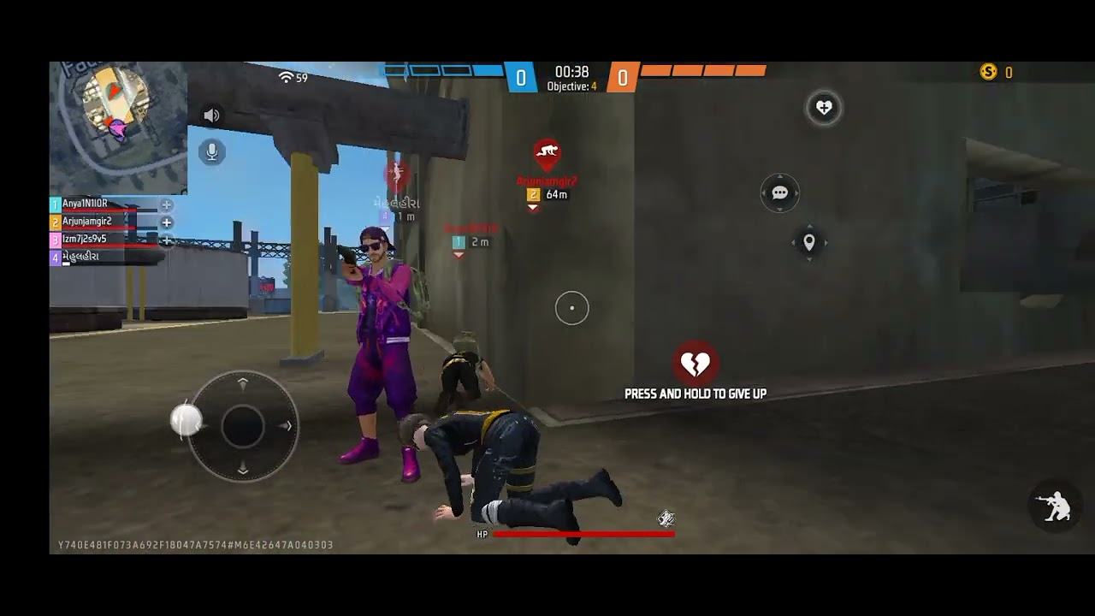
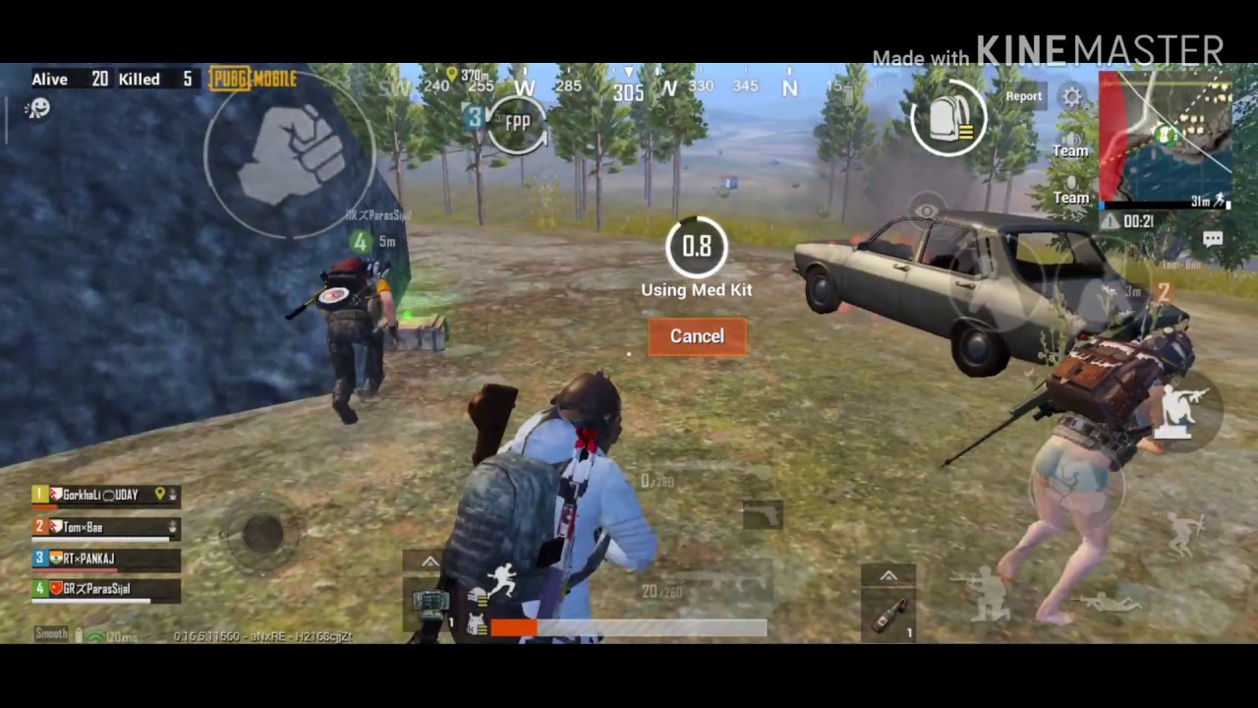
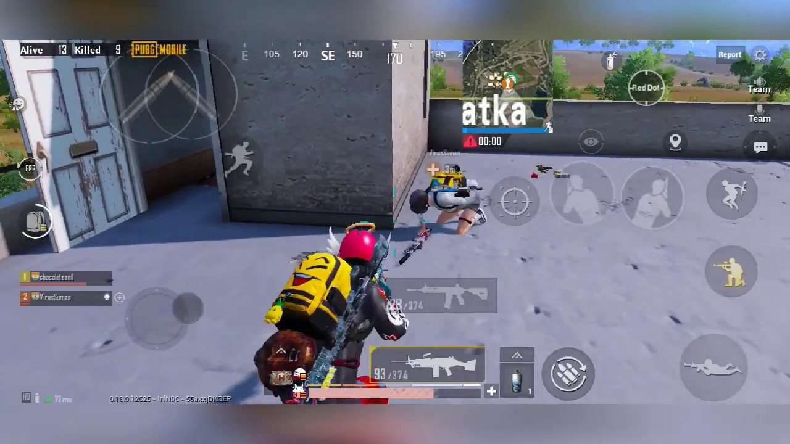
Combat in PUBG:
Engaging with opponents.
Varied environments and ranges.
Requires strategy and aiming skills.
Close-quarters and long-range encounters.
Use of cover and teamwork.
Diverse weapons and explosives.
Adaptability to changing combat situations.
Critical phase for survival and victory.

Slide 9
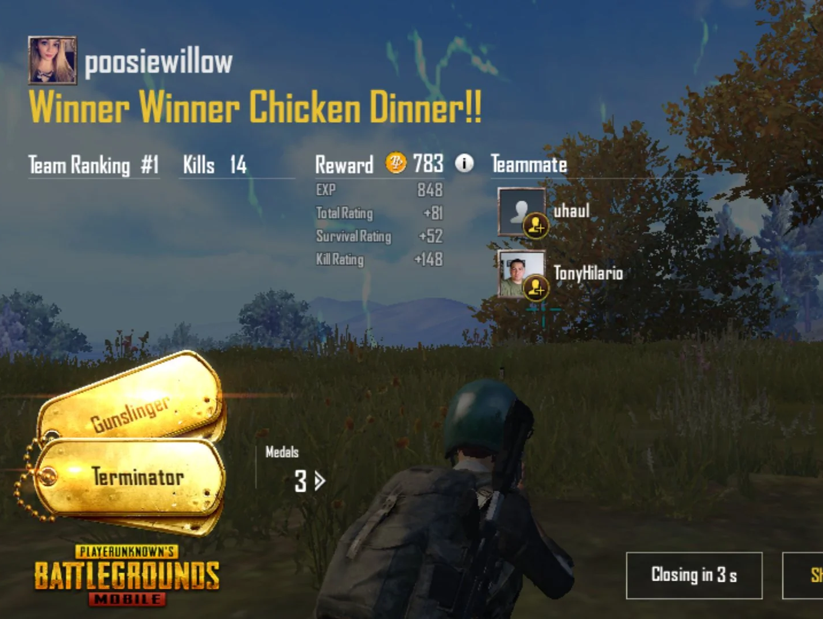
WINNER
In "PlayerUnknown's Battlegrounds" (PUBG), "Winner Winner Chicken Dinner" is a phrase that appears on the screen when a player or team emerges as the victor in a match. It signifies that you've won the game and is a celebratory message. The term has become an iconic catchphrase associated with PUBG's success and the ultimate goal of being the last player or team standing.

Slide 10
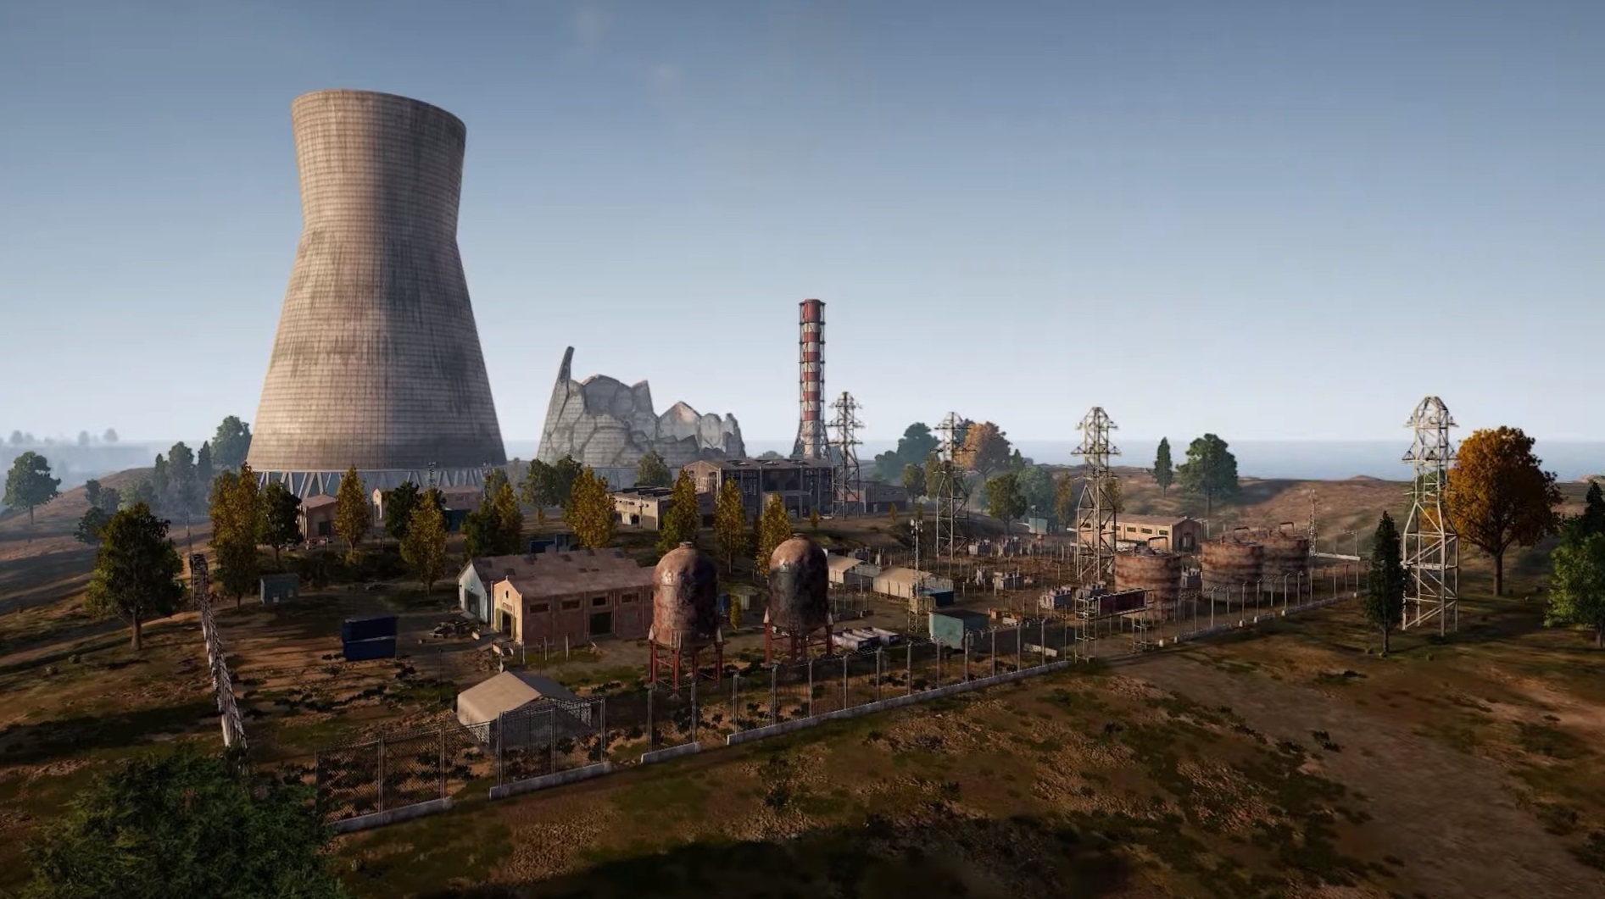
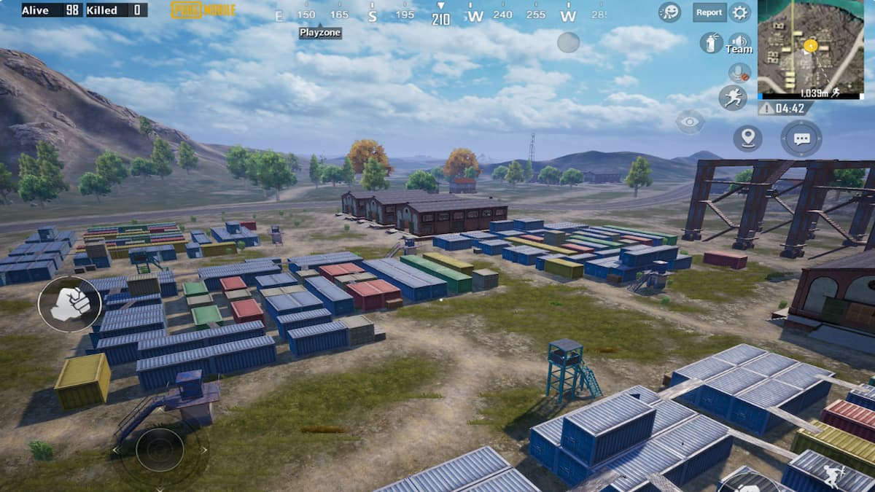
ENVIRONMENT (ERANGEL MAP)
Erangel is an iconic 8x8-kilometer map in PUBG, set on a fictional Russian island. Its diverse terrain includes fields, forests, hills, and urban areas. Players must scavenge for gear while staying within the dynamic playzone, which randomly shrinks, pushing players into combat. Landmarks like the military base and cities like Pochinki create intense hotspots for action. With abundant vehicles and varying weather conditions, Erangel offers a classic and nostalgic PUBG experience.

Slide 11
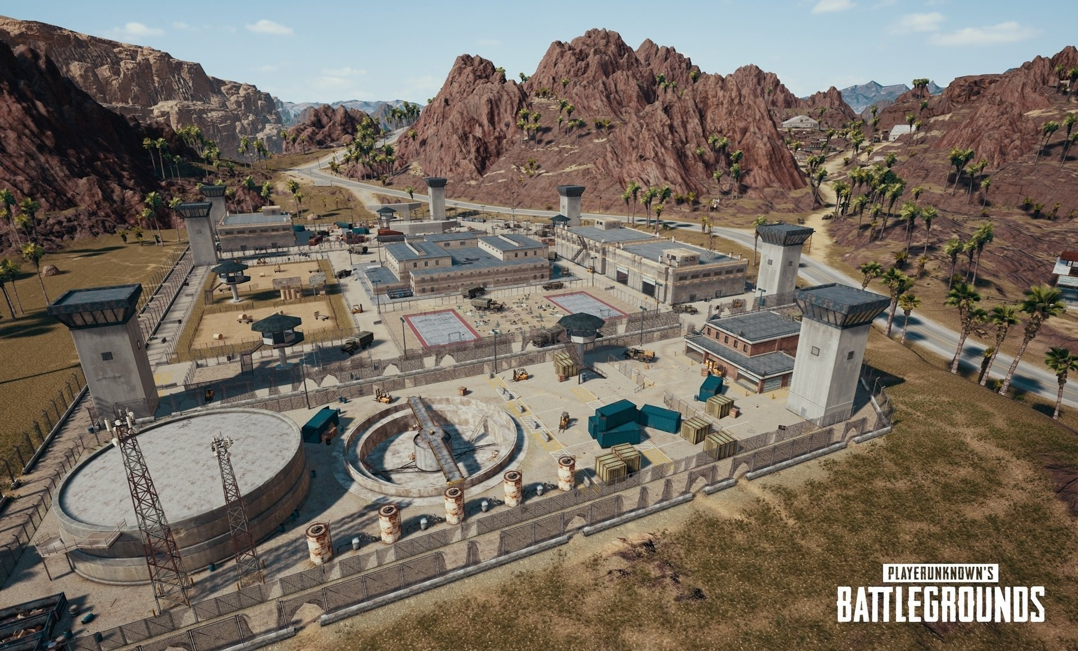
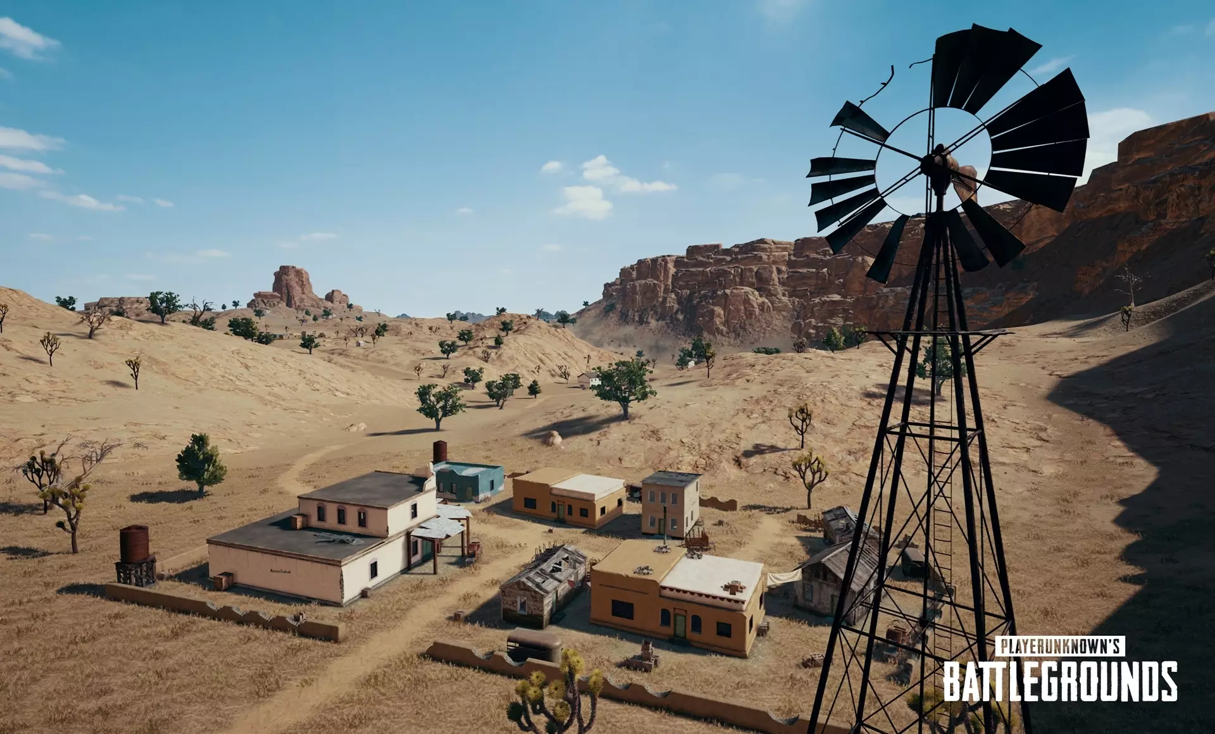
ENVIRONMENT (MIRAMAR MAP)
Miramar is a 8x8-kilometer desert map in PUBG, known for its arid terrain, rocky hills, and urban areas. The map's setting is a Mexican desert landscape, offering a unique contrast to other PUBG maps. Players must adapt to long-range engagements and strategic positioning due to the map's open spaces. Key locations like Hacienda del Patrón and Pecado are hotspots for loot and action. Miramar's diverse terrain, including canyons and valleys, adds depth to gameplay.

Slide 12
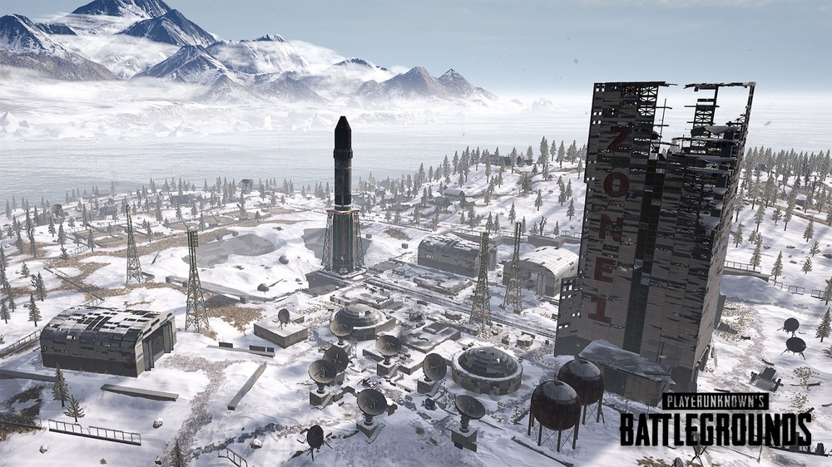
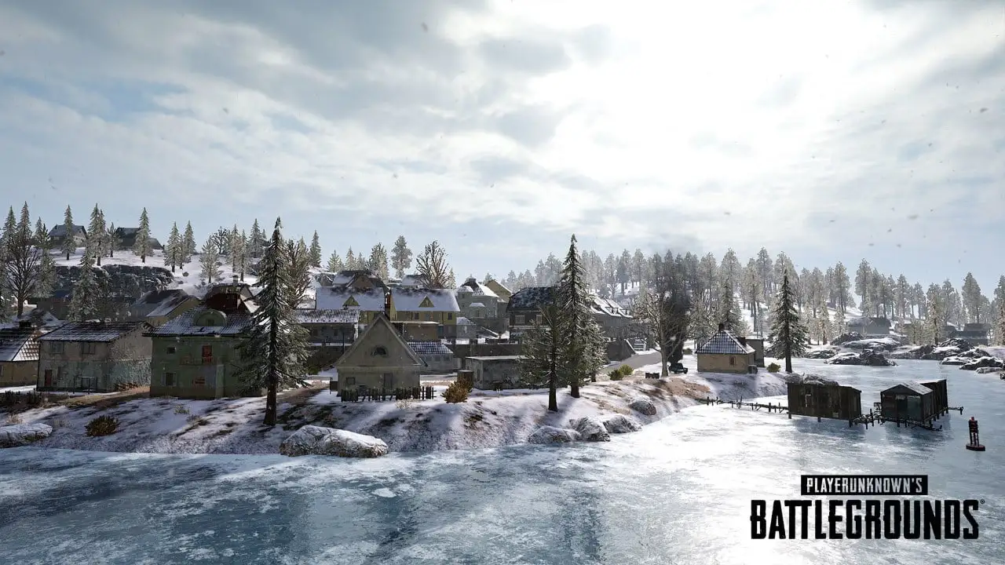
ENVIRONMENT (VIKENDI MAP)
Vikendi is a 6x6-kilometer snow-covered map in PUBG, featuring a mix of open fields, dense forests, frozen lakes, and urban areas. The map's setting is a snowy Adriatic island, offering a unique visual experience. Vikendi is known for its balanced gameplay, catering to both long-range and close-quarters combat. Key locations like Castle and Cosmodrome are popular for loot and encounters. Dynamic weather changes, including snowfall, impact visibility and tactics. Vikendi's smaller size and diverse terrain make it a popular choice for intense PUBG matches.

Slide 13
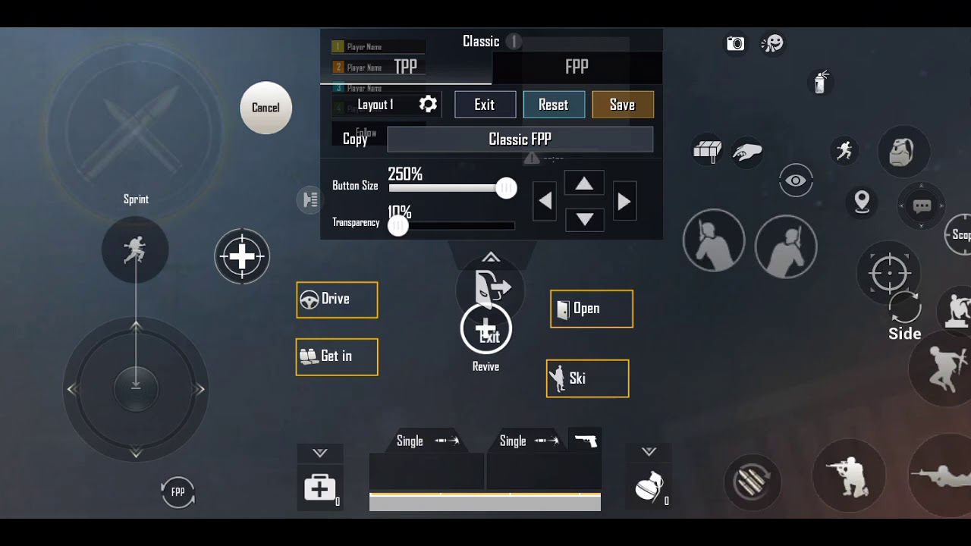
CONTROLS

Slide 14
Mobile Controls (Touchscreen):
Left Side of the Screen: Virtual joystick for character movement (drag your thumb to move).
Right Side of the Screen: Touch anywhere to aim and tap to shoot.
Crouch, Prone, and Jump: Buttons on the right side of the screen.
Scope and Fire Mode: Buttons for aiming down sights (ADS) and changing fire mode.
Inventory and Map: Buttons to access your inventory and map.
Reload: Auto-reloads when you run out of ammo, or you can tap the reload button.
Weapon Selection: Tap the weapon icon on the right side of the screen to switch between primary and secondary weapons.
Grenades and Throwables: Accessible from the inventory, drag them to the throw button to use.
Driving: When in a vehicle, on-screen controls for acceleration, braking, and steering appear.
Interact: Approach items or doors, and an on-screen button will appear for interaction.

Slide 15
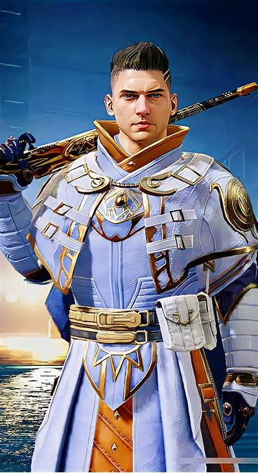
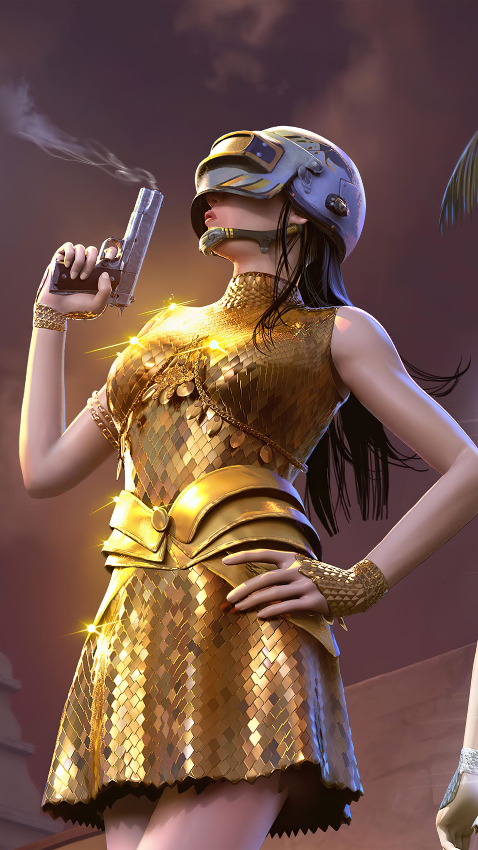
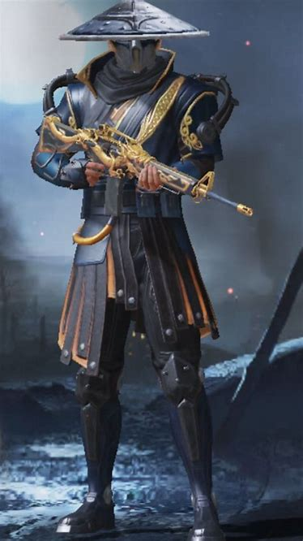
Character CUSTOMIZATION

Slide 16
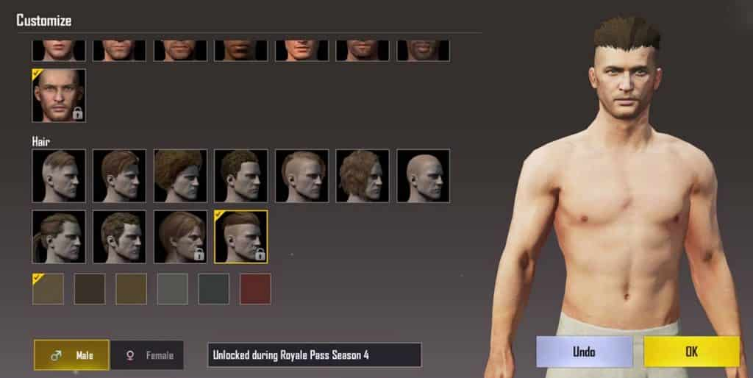
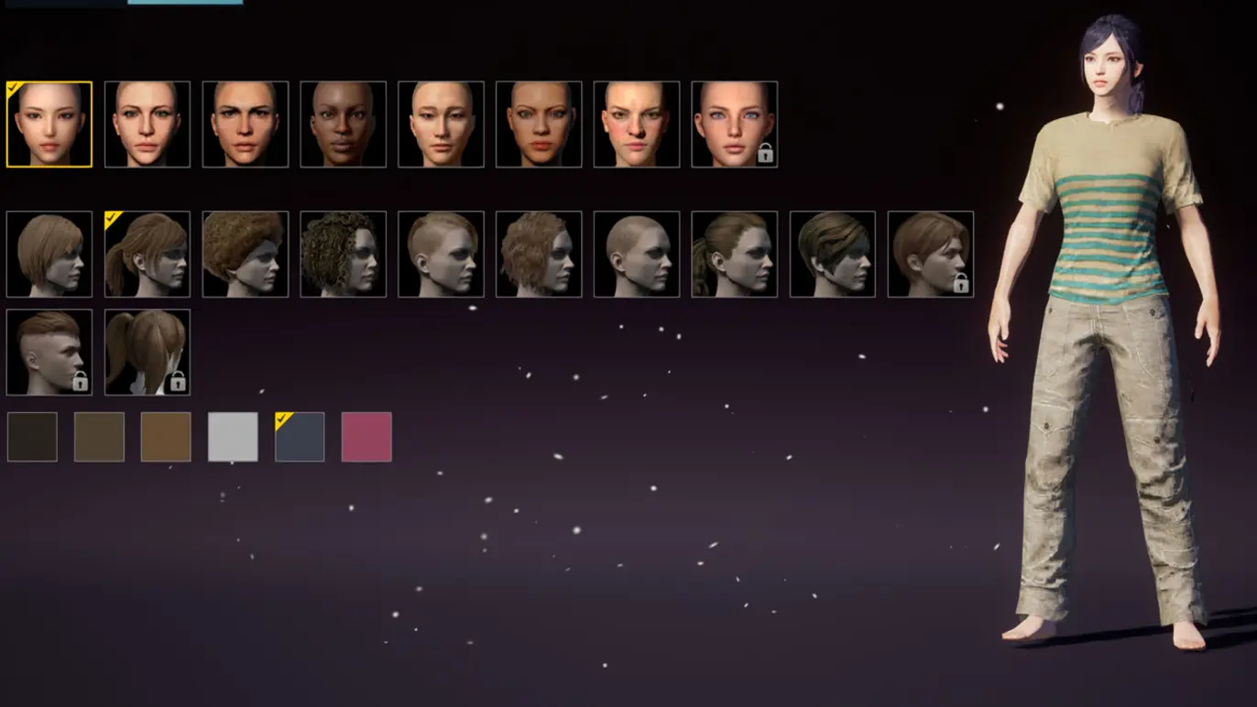
Gender Selection: Depending on the version of PUBG, players may have the choice to select their character's gender, allowing for further personalization. Accessories: Customize your character with accessories like glasses, hats, helmets, masks, and backpacks. Emotes: Equip your character with emotes that allow you to express various emotions or actions during matches, such as dancing or waving. Limited-Time and Event Skins: Participate in in-game events or purchase limited-time skins and cosmetics to stand out with unique items.
Character CUSTOMIZATION

Slide 17
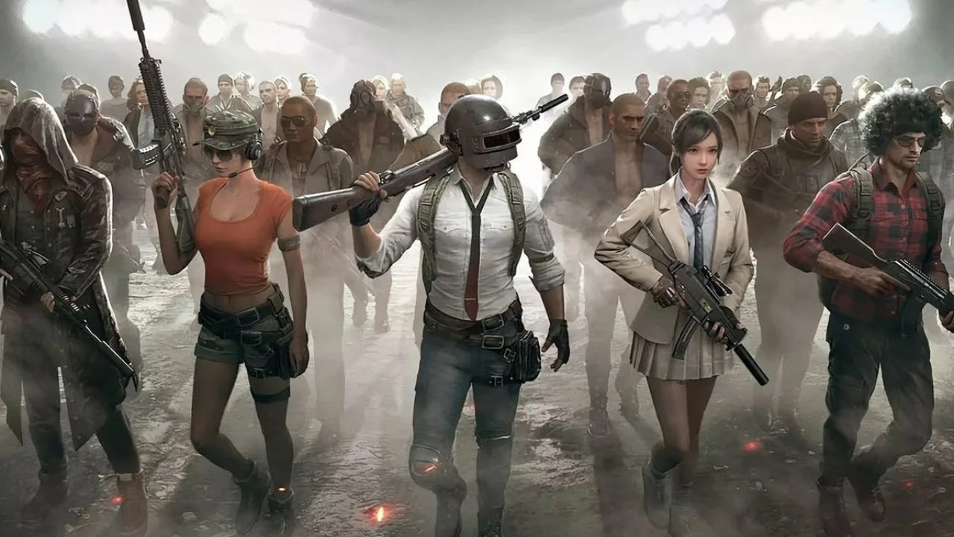
Outfit Sets: Some outfits are sold as complete sets, ensuring a coordinated and stylish look for your character. Crate Openings: Obtain customization items by opening crates obtained through in-game progression or purchases. Customization Progression: As you play more matches and complete missions, you'll unlock additional customization options, encouraging ongoing engagement. Community Market: Depending on the version, you may have access to a community market where you can buy and sell cosmetics with other players. .
Character CUSTOMIZATION

Slide 18
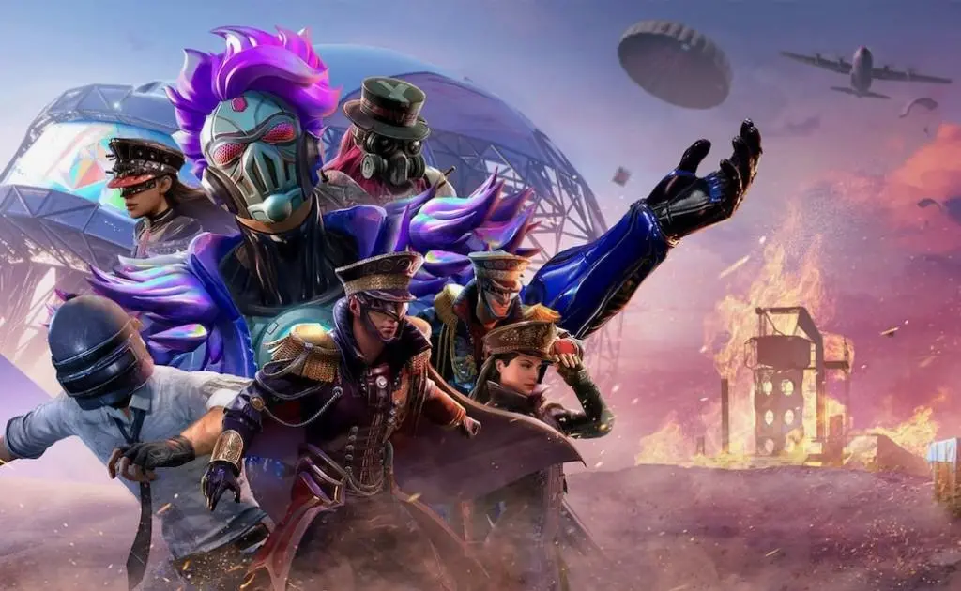
Seasonal Themes: PUBG often introduces seasonal themes with unique customization items, aligning with real-world events or holidays. Preview Feature: Most versions offer a preview option to see how your character will look with selected customization items before applying them. Stat Tracking: Certain cosmetics may track in-game statistics or milestones, showcasing your achievements to others.
Character CUSTOMIZATION

Slide 19
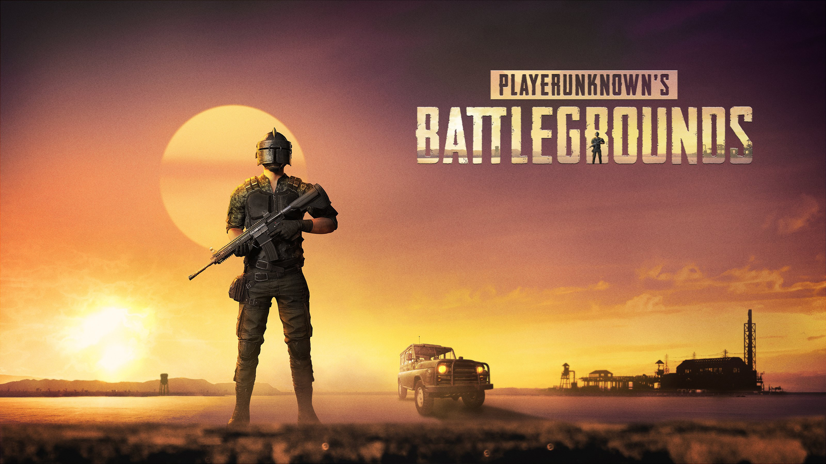
MDEV1003 MOBILE GAME DESIGN
The End
Gurwinder Singh STUDENT ID : 200557497

